Slide 1
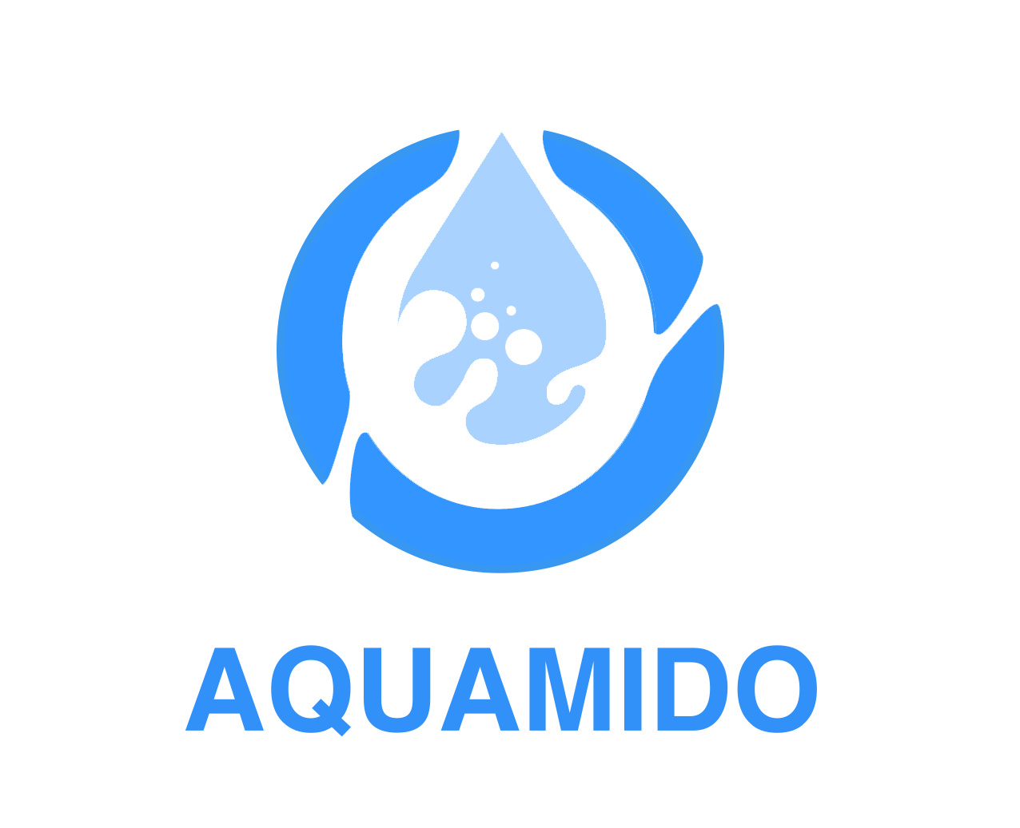
Meddo Tech Water Production Solutions
Reporter：
Anna
lEADTIME :20MINS
PowerPoint Design - - - - - - - - - - - - - - - - - -

Slide 2
/ CATALOGUE
About Us
Water Treatment Solutions
1.
2.
Products and Services
Market Analysis and Outlook
3.
4.
Our Mission and Vision
5.

Slide 3
Part
01
About Us

Slide 4
Company Profile
Expertise and Focus
Industry Position
Manufacturing Capability
Meddo Water Solutions is a leading engineering firm specializing in end- to- end water treatment solutions for challenging environments across the Middle East and Africa. With a decade of field expertise, we deliver innovative desalination, wastewater recycling, and smart water infrastructure systems tailored to combat water scarcity and improve community health.
A South China leading enterprise in water treatment system and solution provider. Over 20 years of experience in the business field.
More than 5000 square meters self- owned factory to fulfill all OEM and ODM purchasing orders all over the world. All main manufacturing processes are under our control.

Slide 5
Our Advantages
Professional Team
Competitive Pricing
Customized Solutions
Professional design team and idea realizing team can ensure the accurate match of customers' needs from different countries and regions. We aim at environment- protection recycling and power- saving, with more intelligent, simpler operating, dynamic monitoring, and easier handling.
The price we offer is more reasonable and equipment is more durable compared to other suppliers.
We provide customized solutions based on the specific requirements of different regions, ensuring the best possible outcomes for our clients.

Slide 6
Part
02
Water Treatment Solutions

Slide 7
Water Pre-treatment
Importance of Pre-treatment
Water pre- treatment is essential for removing large particles, suspended solids, and colloids from raw water. It helps reduce water turbidity and hardness, creating favorable conditions for subsequent treatment processes.
Technologies and Equipment
Advanced pre- treatment technologies such as screens, sedimentation tanks, and filters are used. Customized pre- treatment solutions are designed based on the characteristics of different raw water sources.
Process Flow
The pre- treatment process flow is carefully designed to ensure efficient removal of impurities. Regular maintenance and monitoring of pre- treatment equipment ensure consistent performance.

Slide 8
Core Water Treatment Processes
01
02
03
Desalination Technology
Wastewater Recycling
Smart Water Infrastructure
Meddo employs advanced reverse osmosis technology for desalination. High- pressure pumps force seawater through RO membranes, removing salts and impurities to produce potable water.
Efficient biological and physicochemical treatment processes are used for wastewater recycling. Meddo's systems can treat industrial and domestic wastewater to meet reuse standards, promoting water conservation.
Integration of smart monitoring and control systems ensures optimal performance of water treatment plants. Real- time data analysis helps in predictive maintenance and energy management.

Slide 9
Post-treatment and Packaging
Disinfection and Stabilization
Advanced disinfection methods such as UV and ozone are used to ensure water safety. Post- treatment processes stabilize water quality to meet regulatory standards.
Packaging Solutions
Logistics and Delivery
High- quality packaging materials and advanced packaging equipment are used. Meddo ensures the safety and quality of packaged water during transportation and storage.
Comprehensive logistics solutions ensure timely delivery of products to customers. Meddo's logistics team works closely with clients to meet their specific delivery requirements.

Slide 10
Part
03
Products and Services

Slide 11
Water Treatment Equipment
Pre-treatment Equipment
01
Automatic backwashing filters ensure consistent filtration performance. Efficient sedimentation tanks reduce the footprint of water treatment plants.
Core Treatment Equipment
02
High- efficiency desalination units with low energy consumption. Customized wastewater recycling systems for various industrial applications.
Post-treatment Equipment
03
Advanced disinfection systems ensure microbial safety. Stable water quality is maintained through precision control systems.

Slide 12
Services and Support
Project Consultation and Design
Installation and Commissioning
01
02
Meddo offers comprehensive project consultation and design services. Customized water treatment solutions are developed based on client requirements and site conditions.
Professional installation and commissioning teams ensure smooth setup of water treatment plants. Rigorous testing and validation are conducted to ensure system performance.
Technical Support and Training
03
Ongoing technical support and training are provided to clients. Meddo's technical team assists clients in mastering equipment operation and maintenance.

Slide 13
After-sales Service
Equipment Maintenance
Regular maintenance schedules are established to ensure long- term reliability of equipment. Meddo's service team performs routine checks and repairs to prevent system failures.
System Upgrades
Continuous research and development efforts lead to system upgrades. Clients benefit from improved performance and efficiency through regular upgrades.
Customer Feedback
Meddo values customer feedback and uses it to enhance product and service quality. Regular follow- ups with clients ensure satisfaction and address any concerns promptly.

Slide 14
Part
04
Market Analysis and Outlook

Slide 15
Market Status
Water Scarcity
Water scarcity is a growing global issue, particularly in the Middle East and Africa. Increasing population, urbanization, and industrialization are driving up water demand.
Market Demand
The water treatment market is experiencing rapid growth due to increasing demand for clean water. Governments are implementing policies to support the development and application of water treatment technologies.
Industry Trends
Advancements in technology are making water treatment more efficient and cost- effective. The trend towards decentralized and sustainable water systems is gaining momentum.

Slide 16
Competitive Landscape
Market Position
Strategic Partnerships
Future Prospects
Meddo holds a strong position in the water treatment market, particularly in challenging environments. Our innovative solutions and extensive experience give us a competitive edge.
Meddo collaborates with leading technology providers and research institutions. Strategic partnerships enhance our ability to deliver cutting- edge solutions.
Meddo is committed to continuous innovation and expansion. We aim to become a global leader in water treatment solutions by 2030.

Slide 17
Part
05
Our Mission and Vision

Slide 18
Our Mission
Empowering Arid Regions
Sustainable Development
25%
Meddo's mission is to empower arid regions with climate- resilient water technologies. We balance operational efficiency, environmental stewardship, and long- term affordability.
50%
Our solutions are designed to promote sustainable development in water- scarce areas. We strive to improve water access and quality for communities in need.

Slide 19
Our Vision
Technology Leadership
Regional Water Independence
Ecosystem-Driven Impact
By 2030, Meddo aims to be the foremost innovator in arid- region water resilience. We will pioneer decentralized, solar- hybrid water systems to democratize access to clean water.
Meddo seeks to empower every nation in the Middle East and Africa to achieve 100% water reuse capacity. We aim to provide drought- proof freshwater supplies to enhance regional water security.
Meddo is committed to building climate- adaptive water infrastructures. Our solutions protect vulnerable ecosystems while fueling industrial growth and food security.

Slide 20
Guangzhou Meddo --Anna
Thanks for your attention !

